Slide 1
Precision, Recall, and F1 Score
Objective: Understand evaluation when accuracy fails
Focus on imbalanced datasets
Learn Precision, Recall, F1 Score

Slide 2
Task 1: Why Accuracy Fails
Task 1: Why Accuracy Fails
Accuracy can be misleading when classes are imbalanced.
Scenario: You are building a model to detect terrorists at an airport.
Data: Out of 1,000 people, 999 are not terrorists and only 1 is.
Model: A simple model that always predicts "Not a Terrorist".
Requirement:
1. Calculate the accuracy of this model.
2. Explain why this 99.9% accuracy score is considered a failure in this context.
Scenario: Detect terrorists
999 normal, 1 terrorist
Model predicts all 'Not Terrorist'
Accuracy ≈ 99.9% but useless

Slide 3
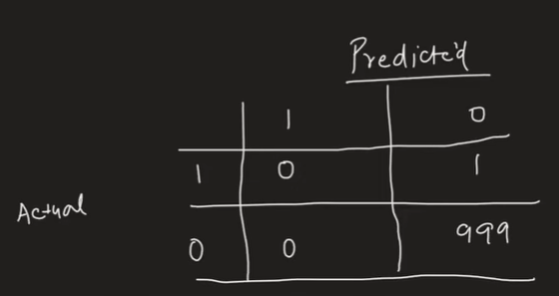
Accuracy Explanation
Correct = 999
Total = 1000
Accuracy = 99.9%
Fails because terrorist not detected

Slide 4
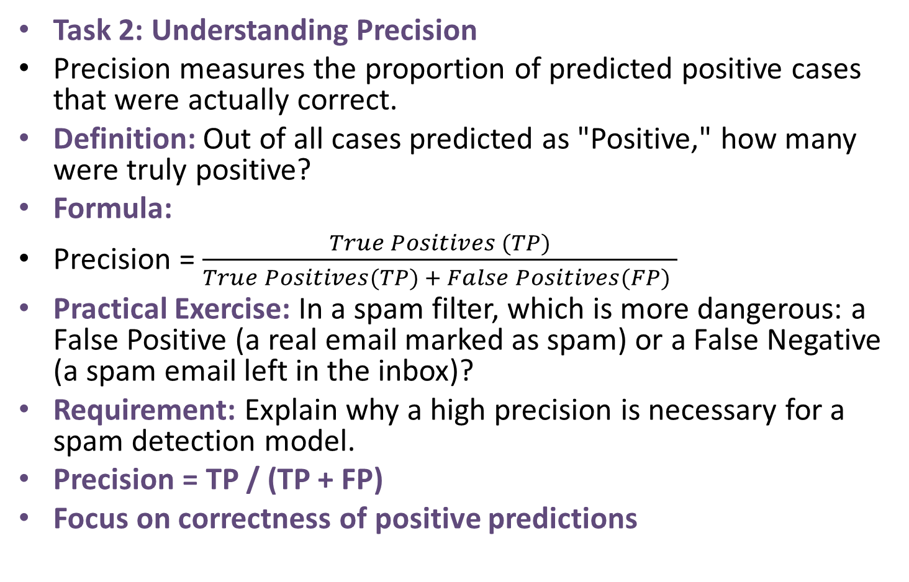
Precision
Task 2: Understanding Precision
Precision measures the proportion of predicted positive cases that were actually correct.
Definition: Out of all cases predicted as "Positive," how many were truly positive?
Formula:
Precision = $\frac{True Positives (TP)}{True Positives(TP) + False Positives(FP) }$
Practical Exercise: In a spam filter, which is more dangerous: a False Positive (a real email marked as spam) or a False Negative (a spam email left in the inbox)?
Requirement: Explain why a high precision is necessary for a spam detection model.
Precision = TP / (TP + FP)
Focus on correctness of positive predictions

Slide 5
Precision Example
Spam filter case
False Positive → real email lost
Need high precision

Slide 6
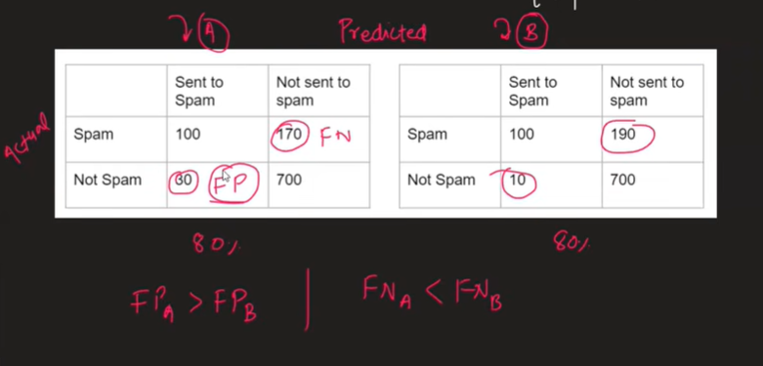
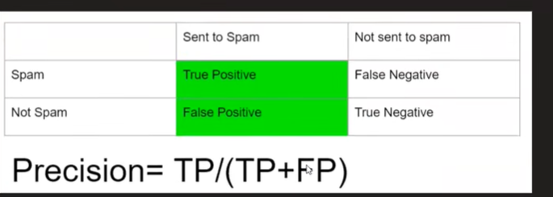

Slide 7
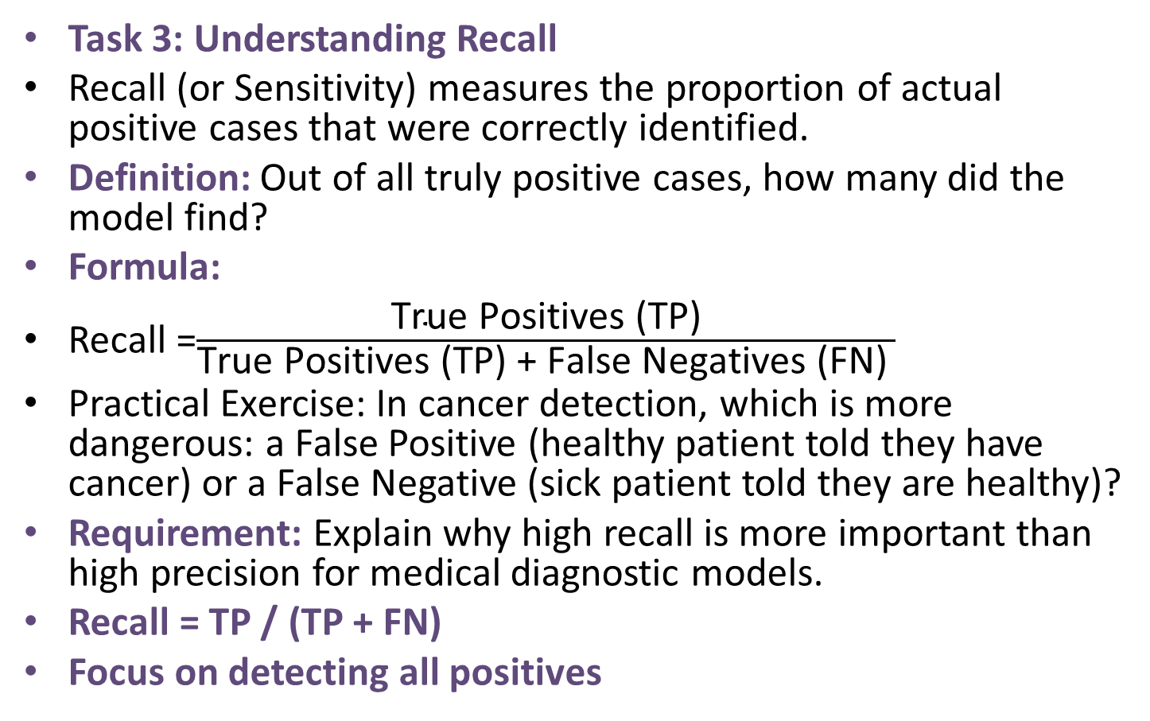
Recall
Task 3: Understanding Recall
Recall (or Sensitivity) measures the proportion of actual positive cases that were correctly identified.
Definition: Out of all truly positive cases, how many did the model find?
Formula:
Recall =$\frac{\text{True} \text{Positives}\text{ (}\text{TP}\text{)}}{\text{True} \text{Positives}\text{ (}\text{TP}\text{) + }\text{False} \text{Negatives}\text{ (}\text{FN}\text{) }}$
Practical Exercise: In cancer detection, which is more dangerous: a False Positive (healthy patient told they have cancer) or a False Negative (sick patient told they are healthy)?
Requirement: Explain why high recall is more important than high precision for medical diagnostic models.
Recall = TP / (TP + FN)
Focus on detecting all positives

Slide 8
Recall Example
Cancer detection
False Negative dangerous
Need high recall

Slide 9
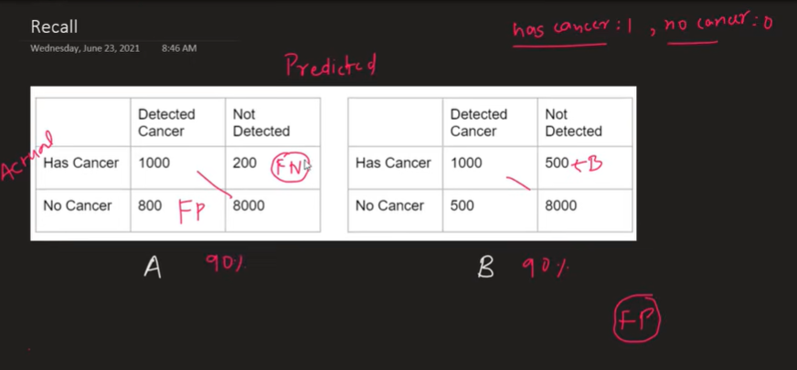
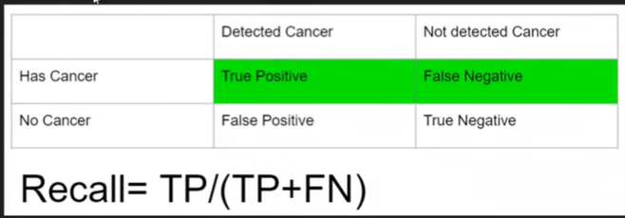

Slide 10
F1 Score
Task 4: The F1 Score (Harmonic Mean)
The F1 Score provides a single value that balances both precision and recall.
Formula: F1 Score = 2 x Precision x Recall Precision + Recall
Why Harmonic Mean? It penalizes extreme values. If either precision or recall is very low, the F1 Score will be low.
Requirement: Calculate the F1 score for two models:
Model A: Precision = 0.8, Recall = 0.8.Model B: Precision = 0.6, Recall = 1.0.
Analysis: Which model is better according to the F1 score?
F1 = 2*(P*R)/(P+R)
Balances precision and recall

Slide 11
F1 Comparison
Model A: 0.8
Model B: ~0.75
Model A better

Slide 12
Multiclass Metrics
Macro Average
Weighted Average
Use classification_report

Slide 13
Submission
Provide calculations
Explain trade-off
Attach sklearn output

Slide 14
Learning Note
Accuracy = basic
Precision/Recall = deeper insight

